Slide 1
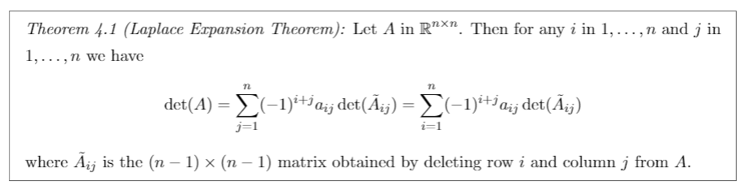
Laplace Expansion Theorem

Slide 2
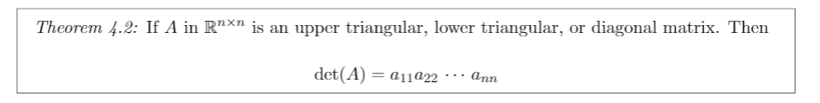
Determinant of Diagonal Types

Slide 3
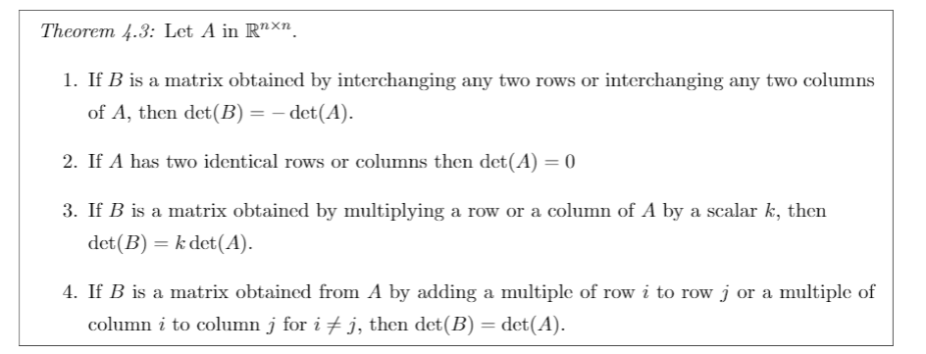
Determinant Row/Col Properties

